Slide 1
LECTURE # 11
GRAPH THEORY

Slide 2
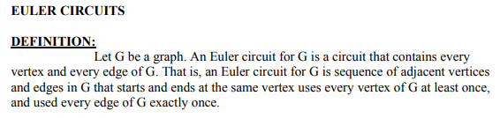
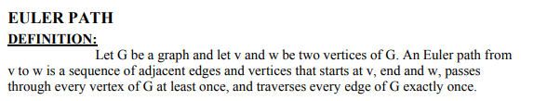


Notes:
i----ller

Slide 3
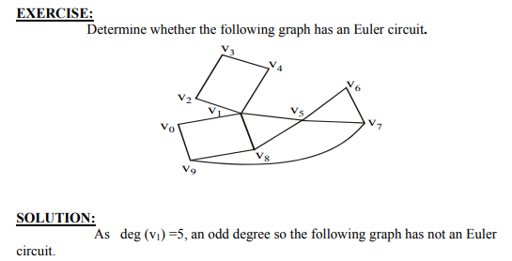

Slide 4
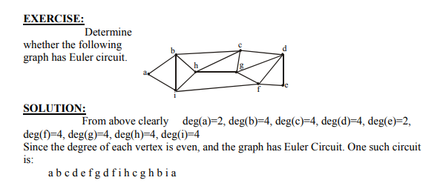

Slide 5
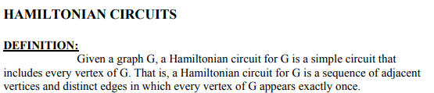
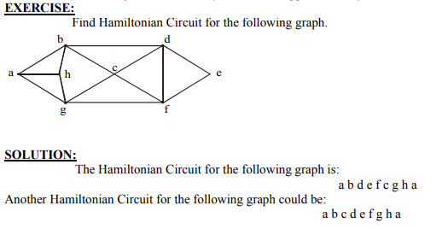

Slide 6
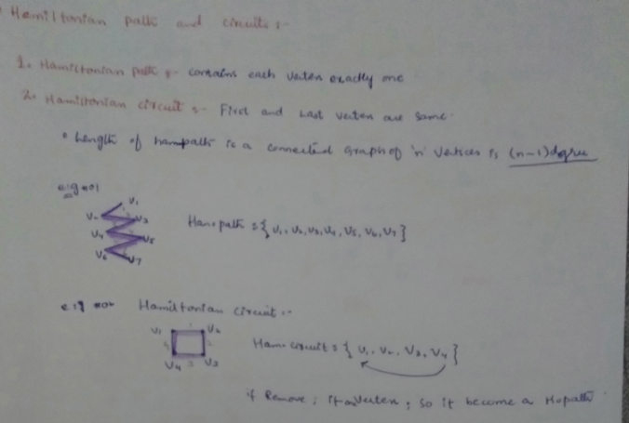

Slide 7
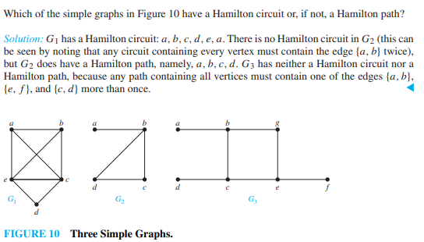

Slide 8


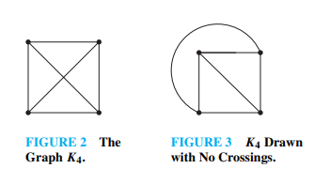
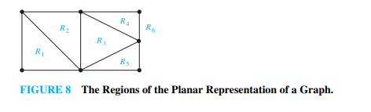
Planar Graph

Slide 9
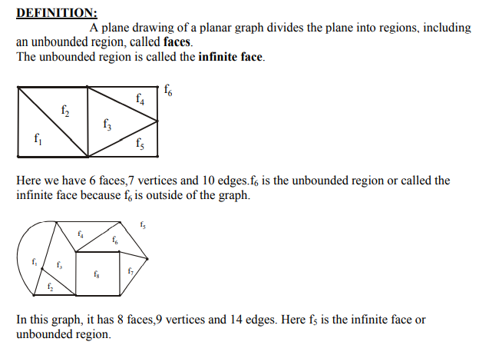

Slide 10
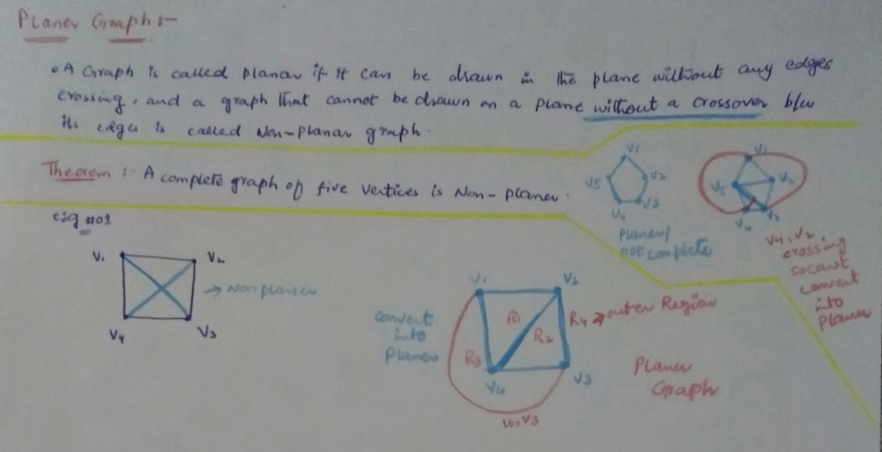

Slide 11
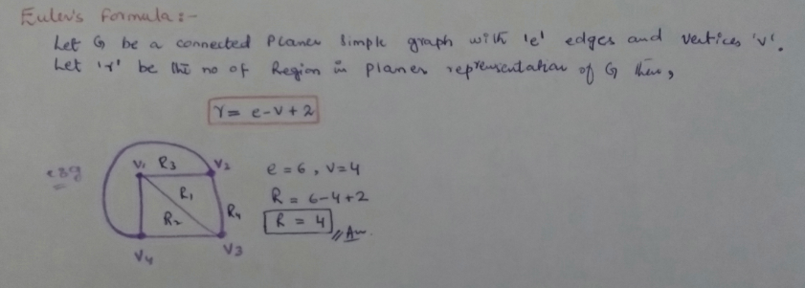

Slide 12
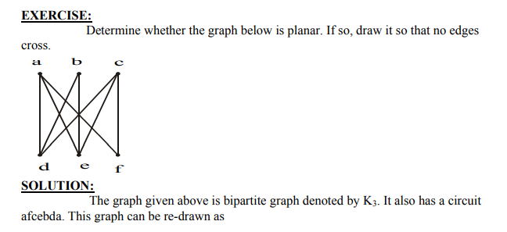
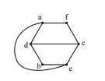

Slide 13
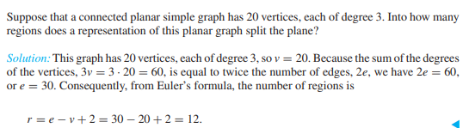

Slide 14


Graph Coloring

Slide 15
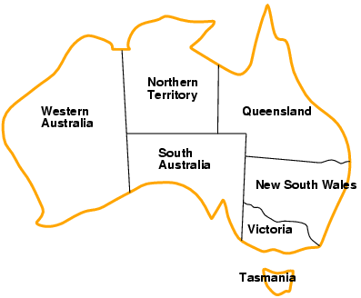
Example: Map-Coloring
Variables WA, NT, Q, NSW, V, SA, T
Domains D_{i} = {red,green,blue}
Constraints: adjacent regions must have different colors e.g., WA ≠ NT, or (WA,NT) in {(red,green),(red,blue),(green,red), (green,blue),(blue,red),(blue,green)}

Slide 16
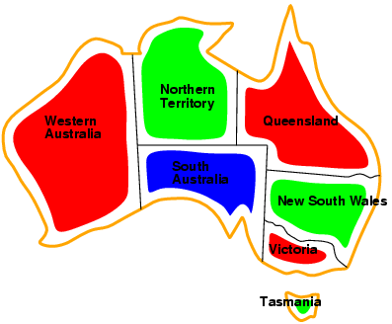
Example: Map-Coloring
Solutions are complete and consistent assignments
e.g., WA = red, NT = green, Q = red, NSW = green,V = red,SA = blue,T = green

Slide 17
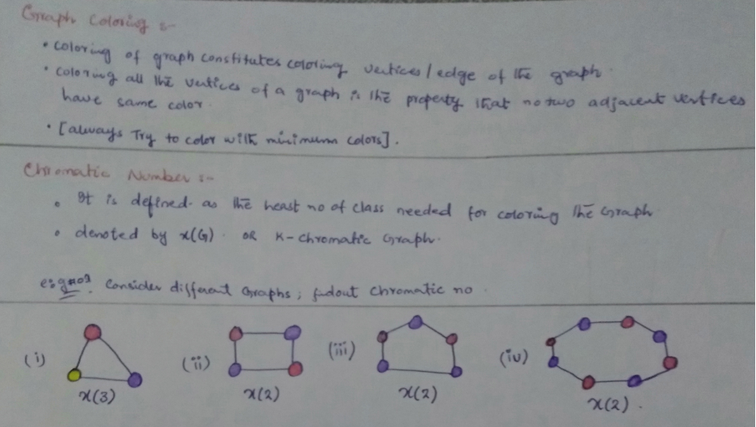

Slide 18
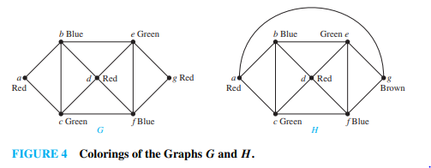

Slide 19
